Slide 1

User Experience and User Interface Design
4 - Android Studio
Dr. Seyed Reza Shahamiri More Info

Slide 2

Android Studio
2
Android Studio (AS) is the native IDE for Android programming.
It uses XML as the UI design language, and Java for backend programming.
The UI Design language is used to determine what UI elements are used, and their locations on the UI in respect to other UI elements.
You need to download and install AS on your machines.
Link to download
Installation instructions

Slide 3
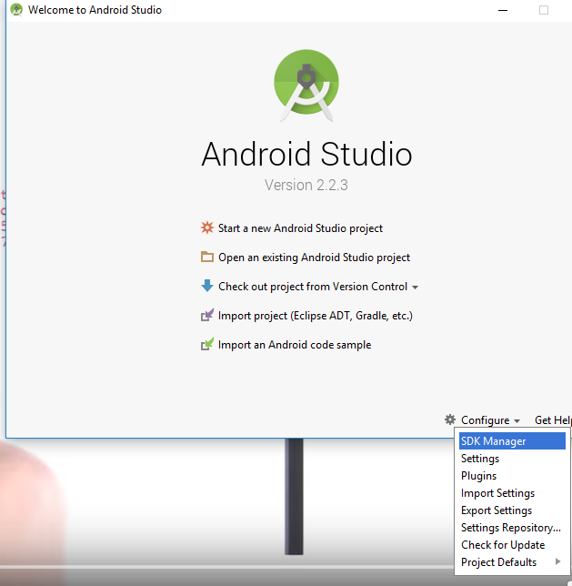
Android Studio SDK Manager
3
After the installation is finished, run Android Studio and select the SDK Manager to ensure the following Android Versions are installed:

Slide 4
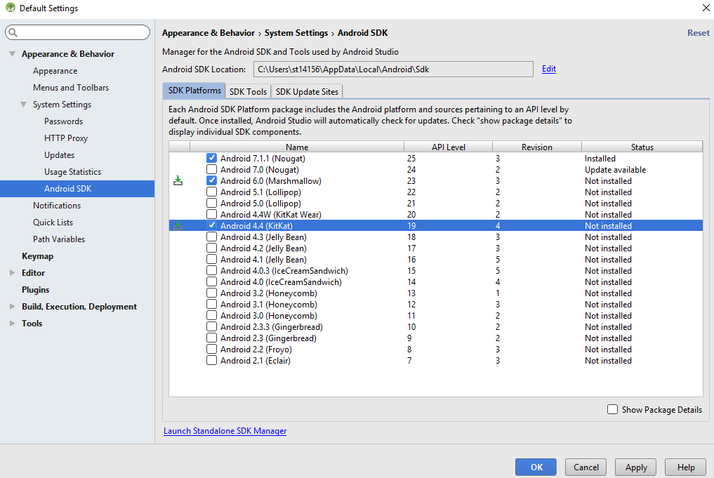
Android Studio SDK Manager
4
Check Android 6.0 and 4.4 are selected and press “Apply”, then wait until they are installed.

Slide 5
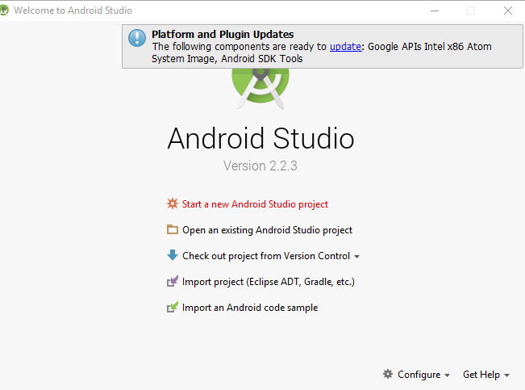
Android Studio Creating New Projects
5

Slide 6
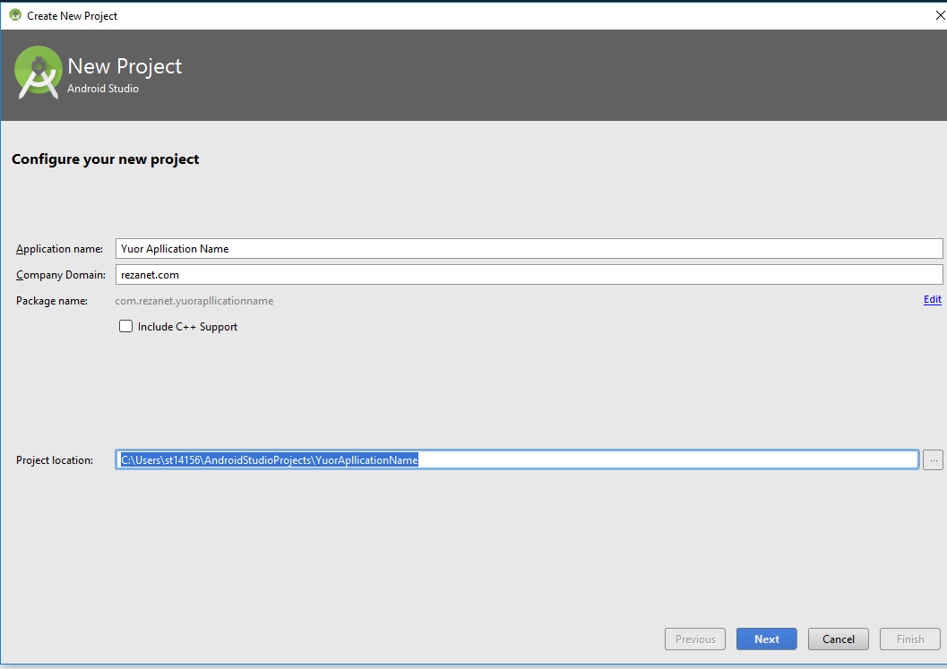
Android Studio Creating New Projects Naming your Project
6
Enter your app name
Enter your company name. it is used to identify your app after it is installed.
Select where you want to store the project

Slide 7
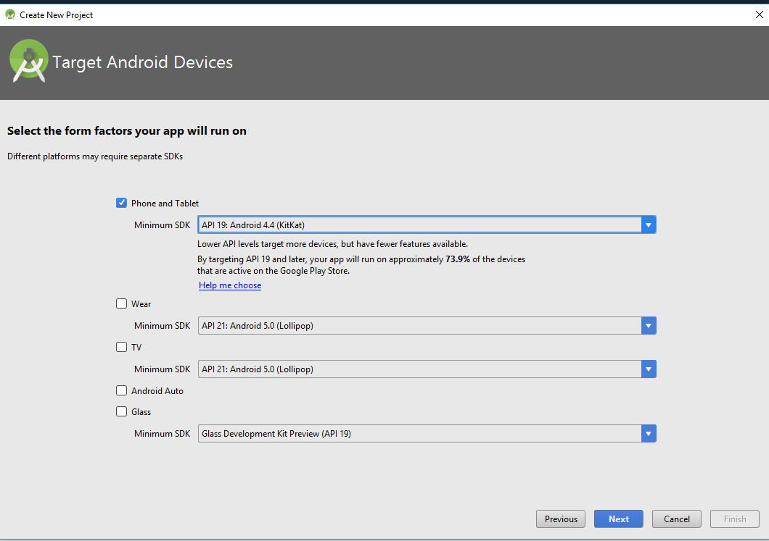
Android Studio Creating New Projects Selecting Android SDK
7
Select the minimum SDK (i.e. Android Version) for your app.

Slide 8
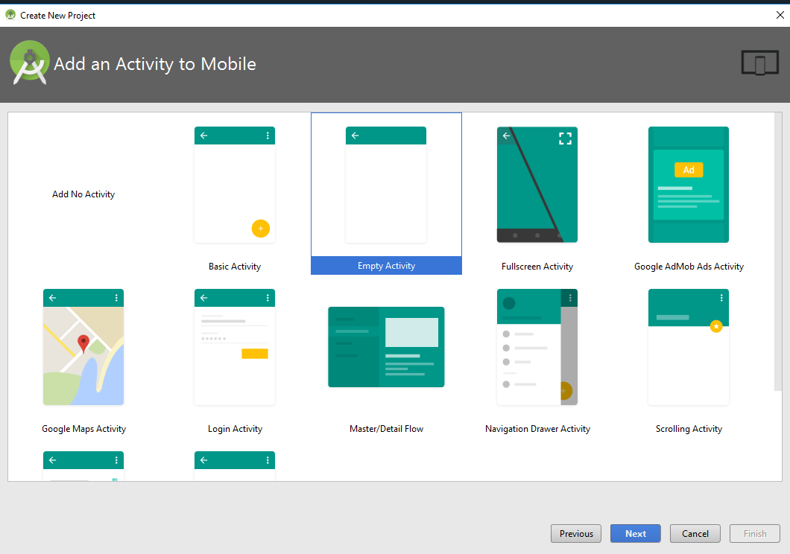
Android Studio Creating New Projects Selecting Initial Activity Template
8

Slide 9
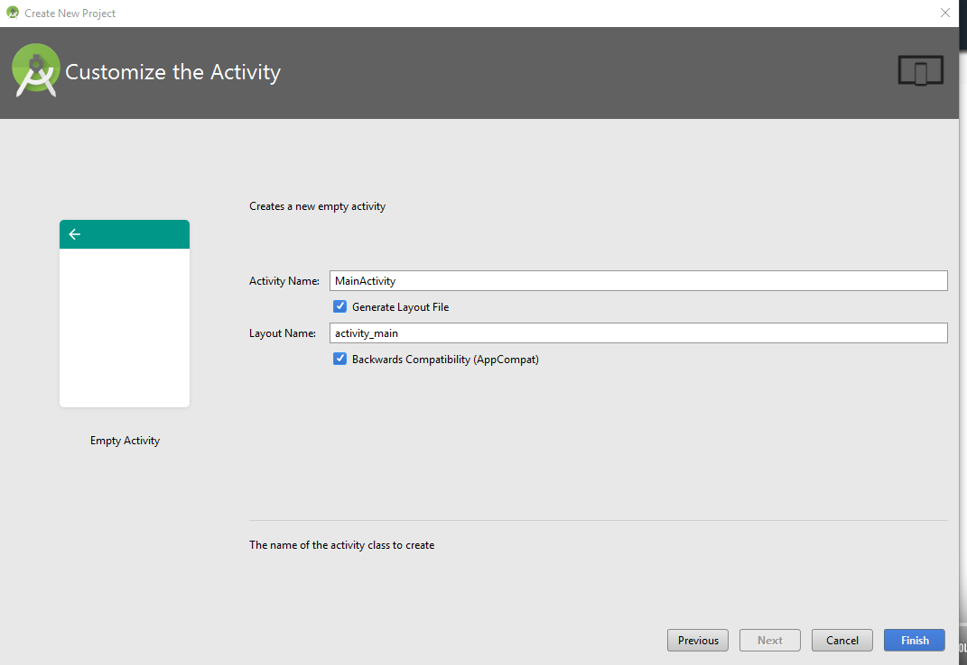
Android Studio Creating New Projects Naming The Main Activity
9

Slide 10
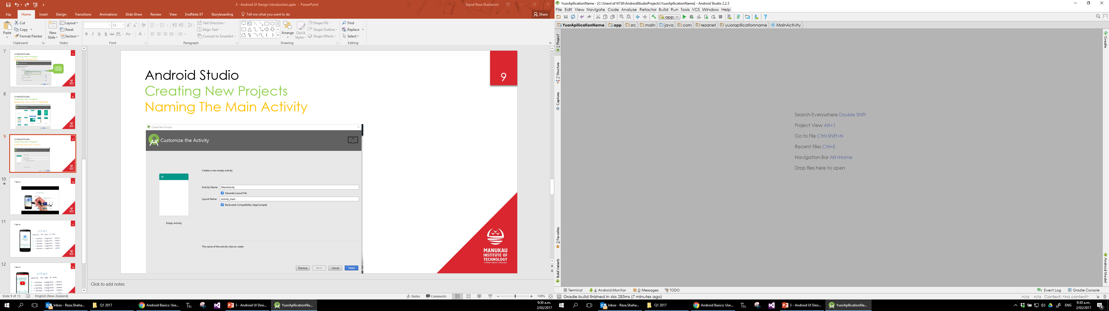
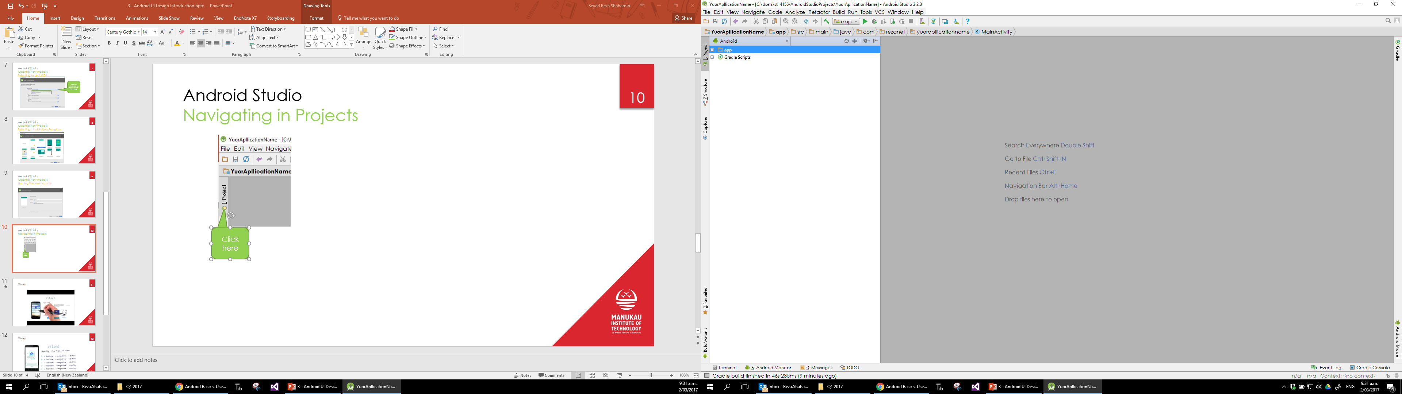
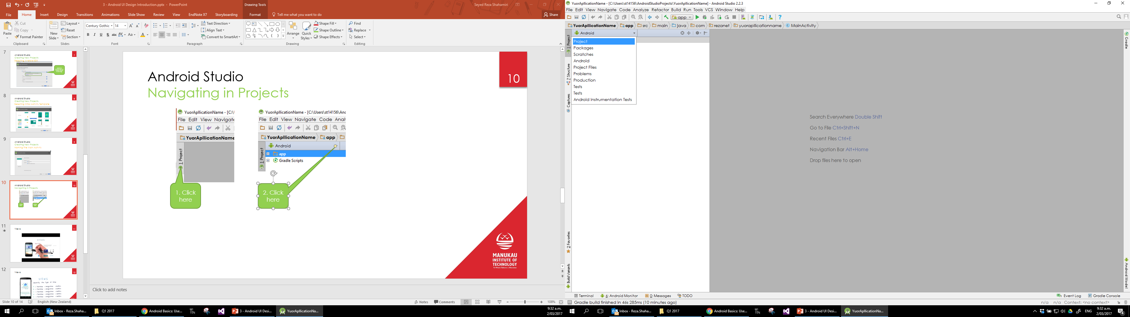
Android Studio Navigating in Projects
10
1. Click here
2. Click here
3. Select Projects

Slide 11
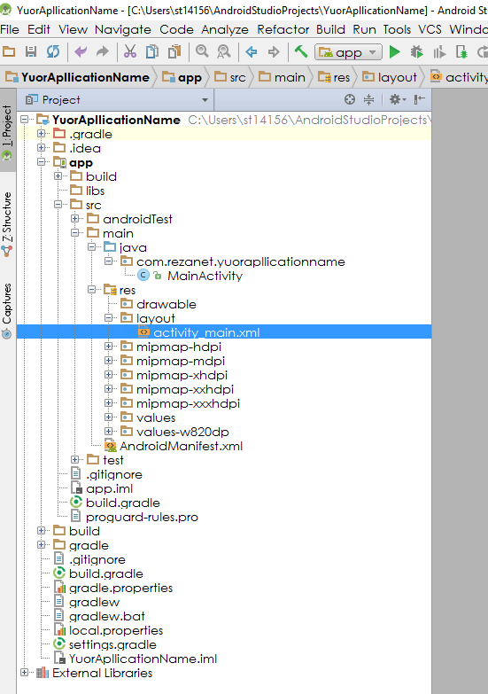
Android Studio Navigating in Projects
11
All Java backend code
All XML UI code

Slide 12
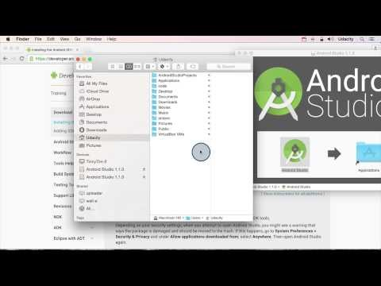
Android Studio Tour
12

Slide 13
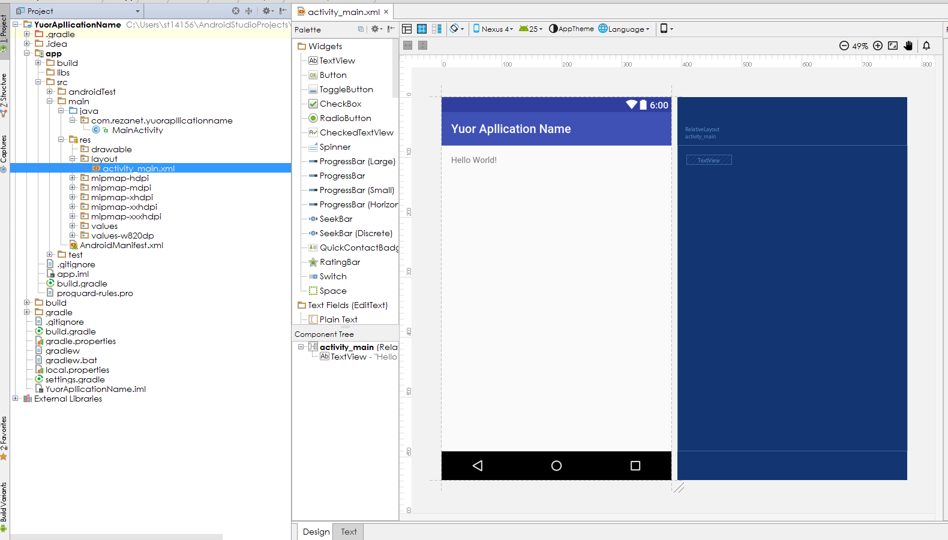
Android Studio Example 1
13
Open the activity XML file:
Select Text

Slide 14
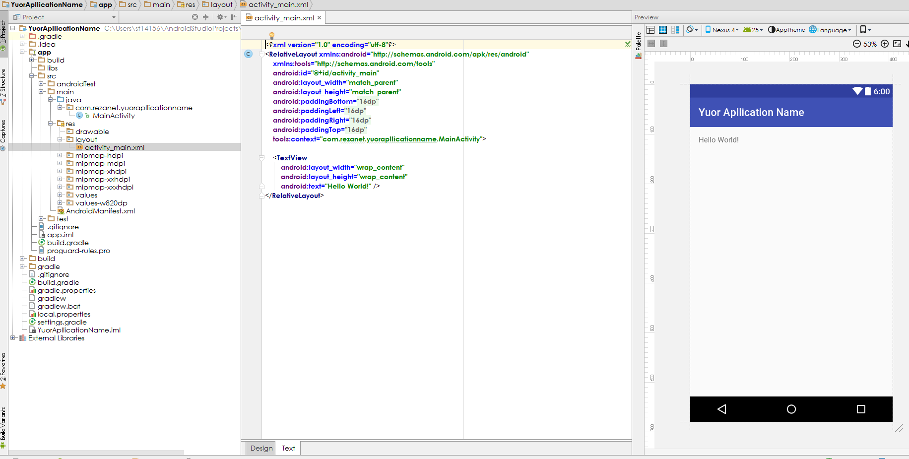
Android Studio Example 1
14
WYSWYG of the GUI
The GUI Code

Slide 15
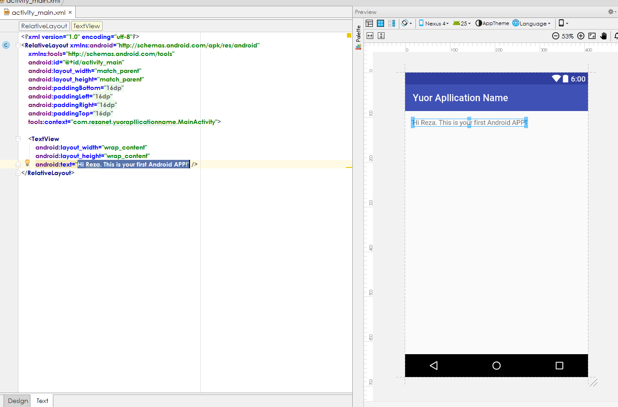
Android Studio Example 1
15
Change “Hello World!” to this text.

Slide 16
Android Studio Testing Your APP
16
There are two ways to test your APP:
Using the built in Emulator (aka Android Virtual Device) to create virtual device(s)
Using a actual Android Device

Slide 17
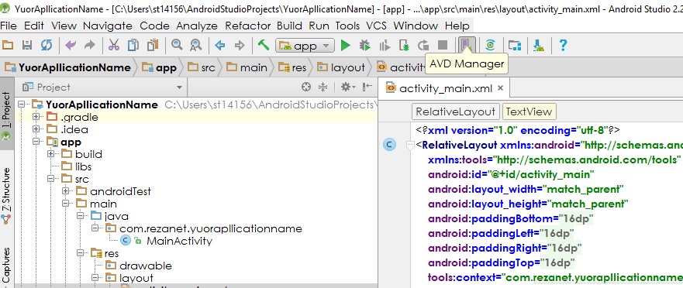
Android Studio Testing Your APP 1 – Using Android Virtual Device
17
Run AVD Manager

Slide 18
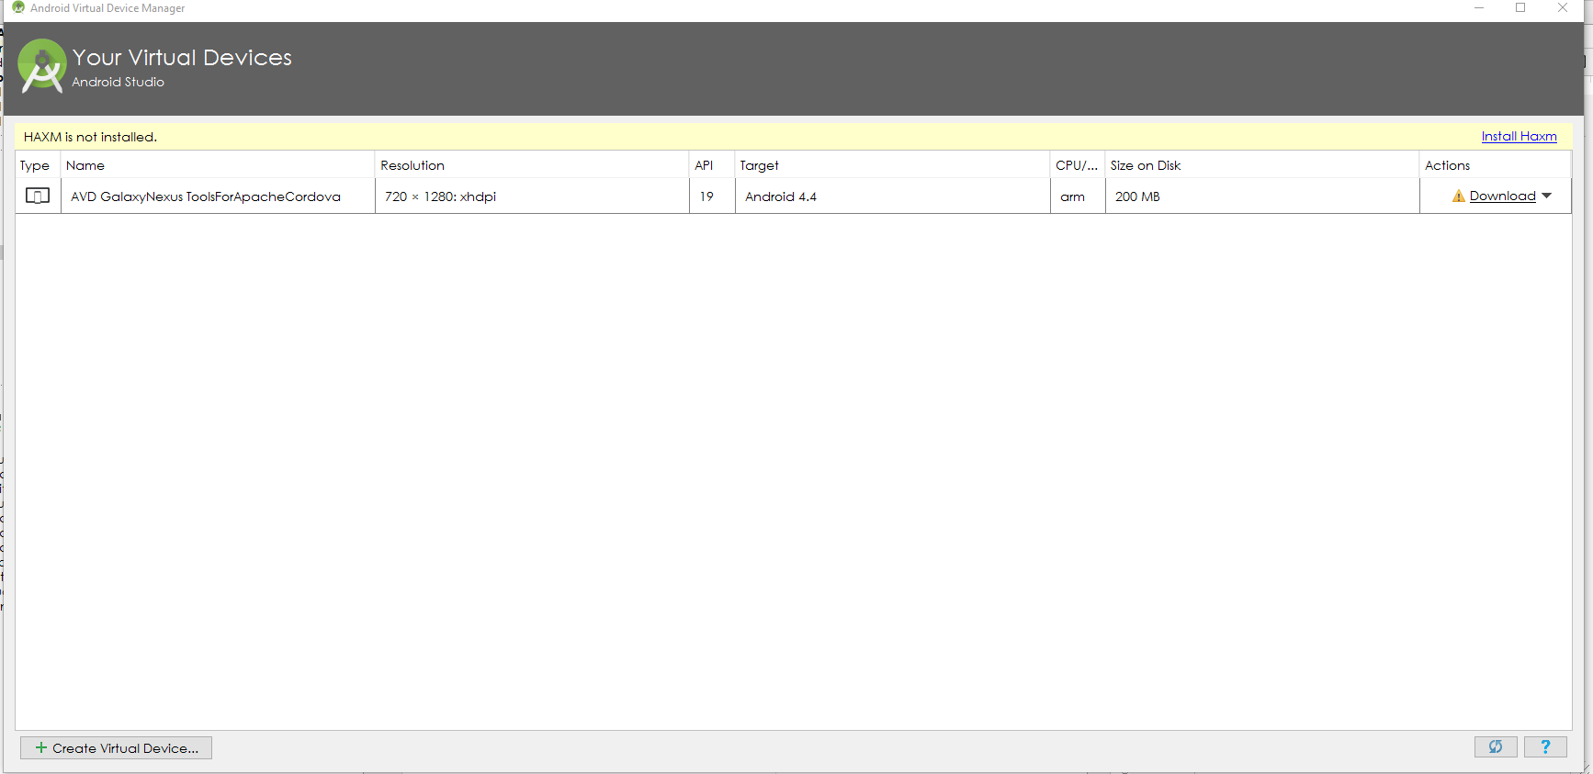
Android Studio Testing Your APP 1 – Using Android Virtual Device
18
List all your install VDs
Click here to create new VDs

Slide 19
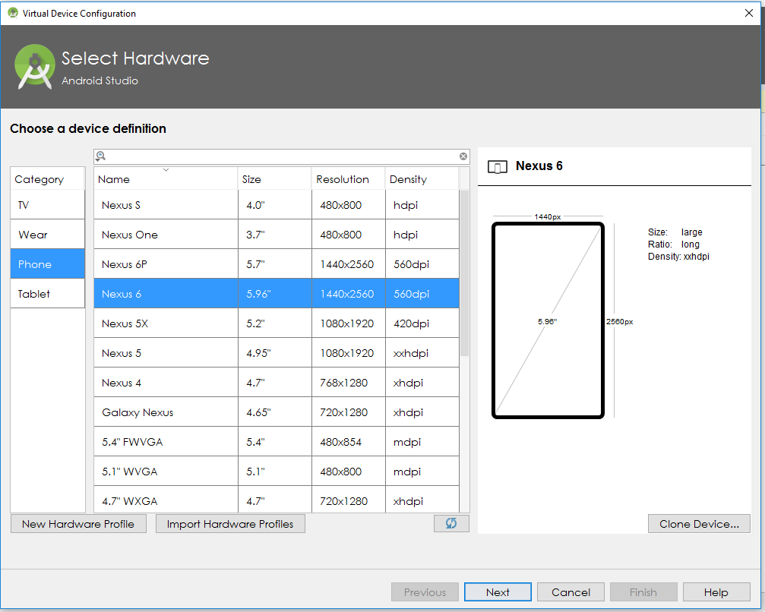
Android Studio Testing Your APP 1 – Using Android Virtual Device
19
Select your preferred VD and press “Next”

Slide 20
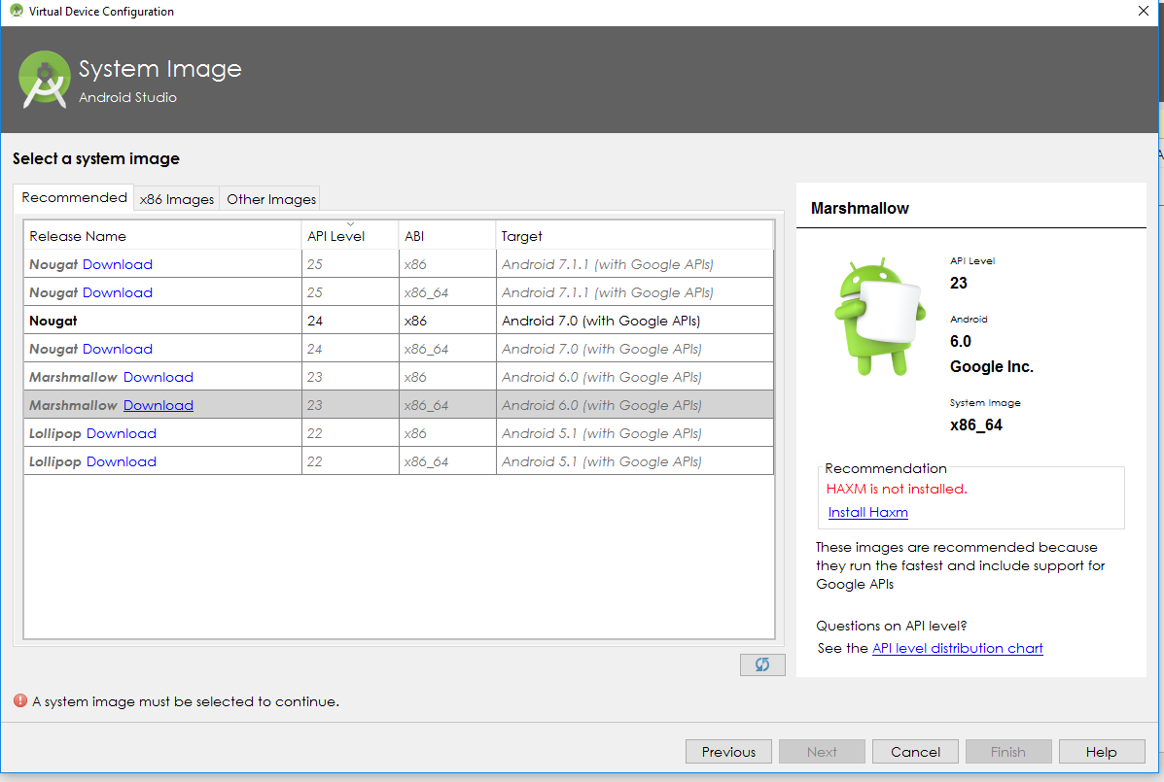
Android Studio Testing Your APP 1 – Using Android Virtual Device
20
Select the API Version to be installed on the VD, and download them if required. Once done, press “Next”
Check the recommendations and apply them, and wait until it’s done (if any)

Slide 21
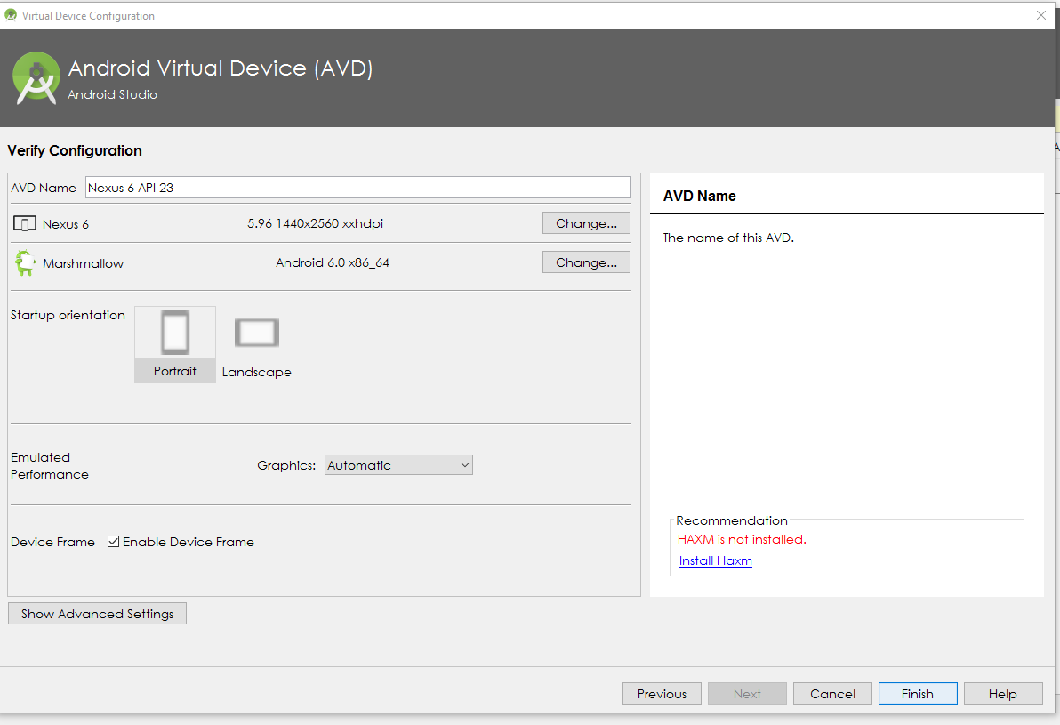
Android Studio Testing Your APP 1 – Using Android Virtual Device
21
Press “Finish”

Slide 22
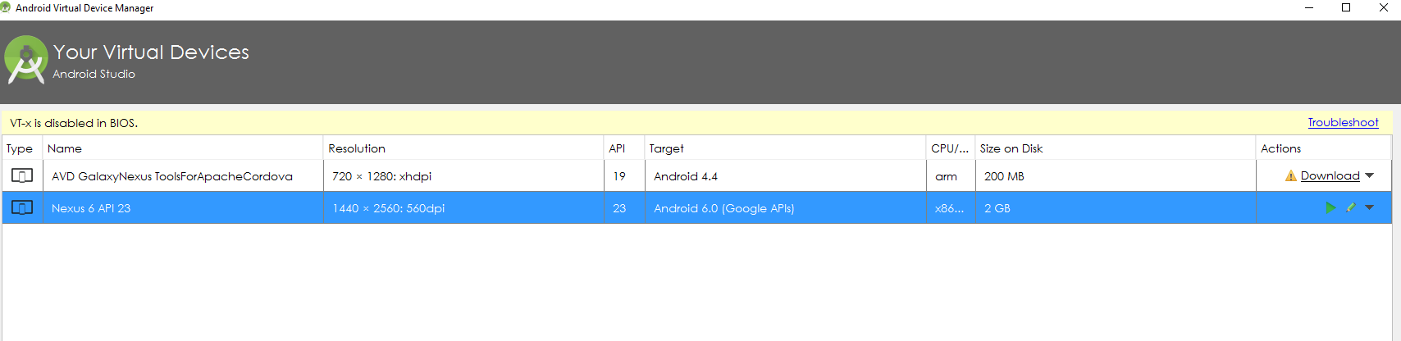
Android Studio Testing Your APP 1 – Using Android Virtual Device
22
Run your VD

Slide 23
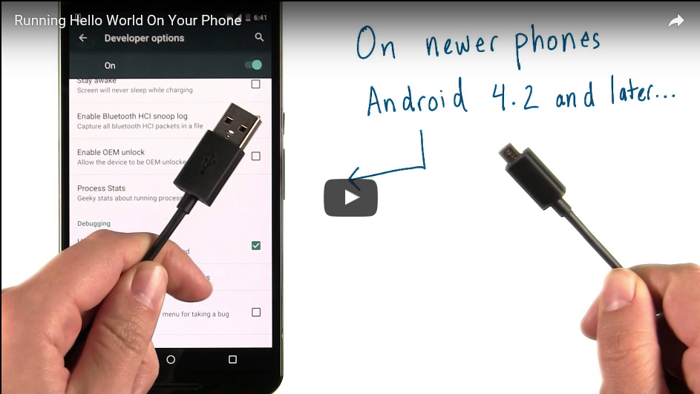
Android Studio Testing Your APP 2 – Using Actual Android Device
23

Slide 24
Android Studio Testing Your APP 2 – Using Actual Android Device
24
Preparation: You need to follow these steps for the first time that you want to use a test device:
Enable developer mode on your phone as shown in the previous video.
Enable USB Debugging on your phone. Again, Google “Enable USB Debugging” followed by your phone model.
Connect your phone to your computer using a proper USB cable.
You may need to install USB Driver for your device too in case your computer doesn’t recognize your phone.

Slide 25
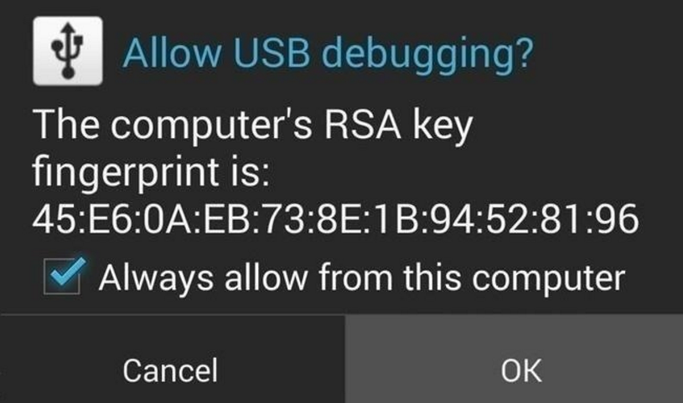
Android Studio Testing Your APP 2 – Using Actual Android Device
25
Note: One additional step for some users. When you connect a newer Android phone to your computer, the phone might show a dialog asking whether to accept an RSA key that allows debugging through this computer. Select "Always allow from this computer" and hit OK.
Troubleshooting

Slide 26
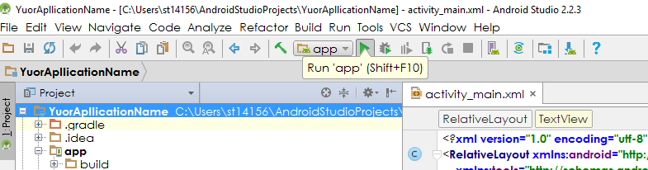
Android Studio Testing Your APP 2 – Using Actual Android Device
26
Now, you can test your app on your device by pressing the “Run” button:

Slide 27
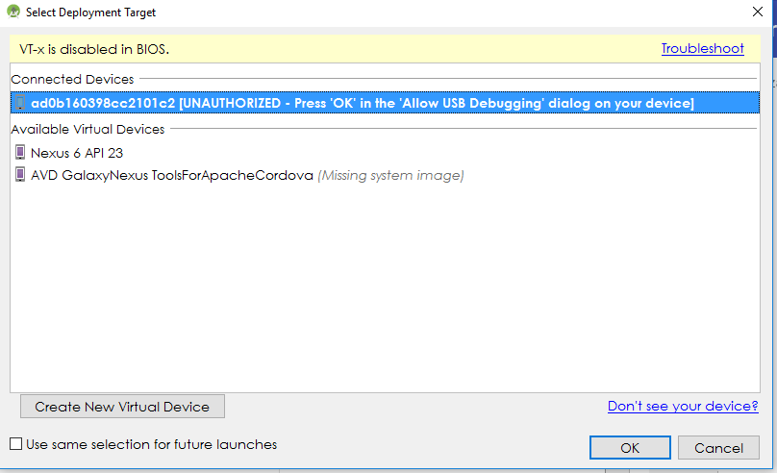
Android Studio Testing Your APP 2 – Using Actual Android Device
27
After running the app, you should see the following window asking which device to deploy the app to. Select you connected device and press “OK”. Then check your phone.

